Slide 1
Legislative / Regulatory
Update
By Michael T. Oscar
Director of Government Relations
American Subcontractors Association
American Subcontractors Association
1004 Duke St., Alexandria, VA 22314
www.asaonline.com | www.subexcel.com | http://contractorscompass.org

Slide 2
State of Play
“Unlike in the past, where we were unified and drew in allies, currently our own commons seems to be breaking apart. What concerns me most as a military man is not our external adversaries; it is our internal divisiveness. We are dividing into hostile tribes cheering against each other, fueled by emotion and a mutual disdain that jeopardizes our future, instead of recovering our common ground and finding solutions.”
General Jim Mattis, former Defense Secretary, per his essay, “Duty, Democracy and the Threat of Tribalism.”
American Subcontractors Association
www.asaonline.com | www.subexcel.com | http://contractorscompass.org

Slide 3
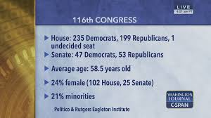
American Subcontractors Association
www.asaonline.com | www.subexcel.com | http://contractorscompass.org

Slide 4
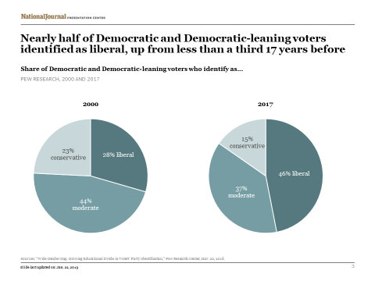
American Subcontractors Association
www.asaonline.com | www.subexcel.com | http://contractorscompass.org

Slide 5
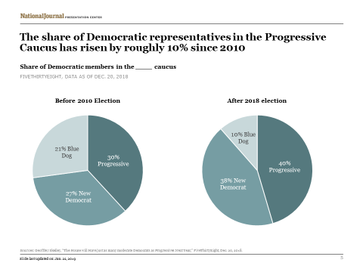
American Subcontractors Association
www.asaonline.com | www.subexcel.com | http://contractorscompass.org

Slide 6
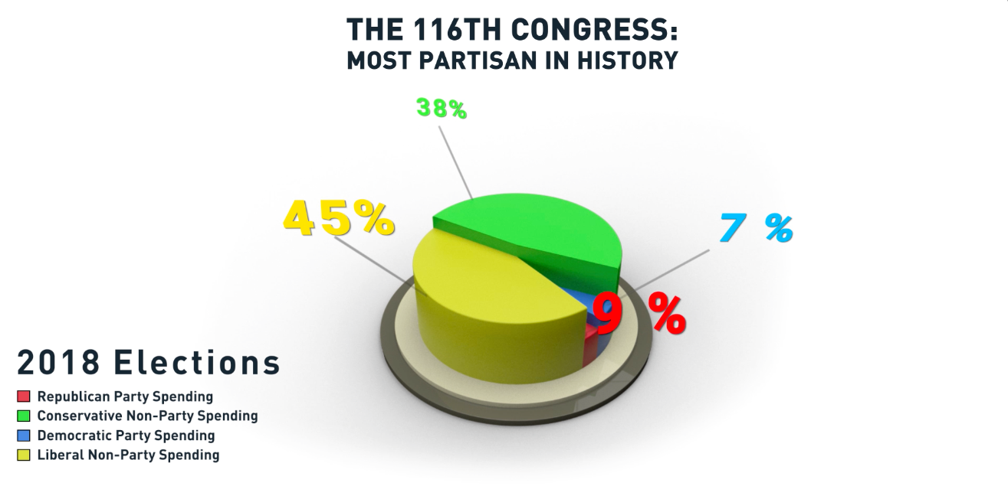
American Subcontractors Association
www.asaonline.com | www.subexcel.com | http://contractorscompass.org

Slide 7
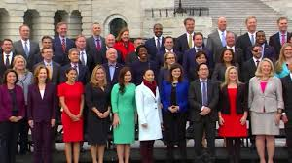
U.S. House
American Subcontractors Association
www.asaonline.com | www.subexcel.com | http://contractorscompass.org

Slide 8
American Subcontractors Association
www.asaonline.com | www.subexcel.com | http://contractorscompass.org

Slide 9
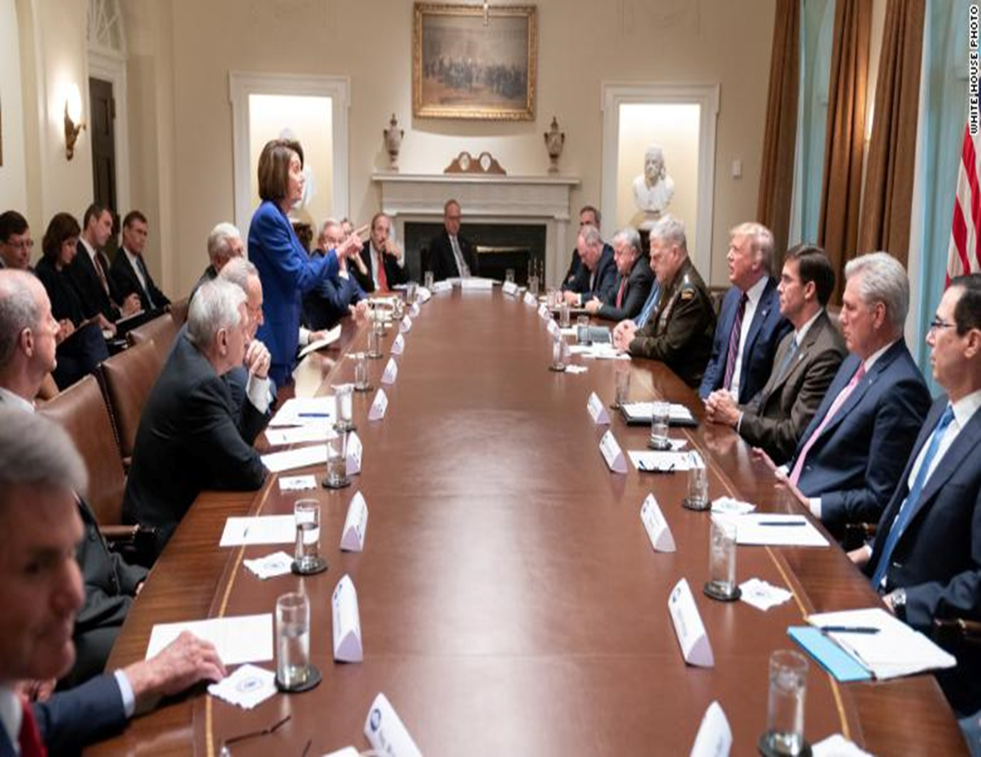
October 15, 2019 : White House Syria Meeting
American Subcontractors Association
www.asaonline.com | www.subexcel.com | http://contractorscompass.org

Slide 10
Colorado Congressional Delegation
Sen. Bennett (D)
Committees
Finance
Sen. Gardner (R)
Committees
Commerce
Science & Transportation
Energy & Natural Resources
American Subcontractors Association
www.asaonline.com | www.subexcel.com | http://contractorscompass.org

Slide 11
Colorado Congressional Delegation
7 Congressional Districts
Member | Committee
Rep. DeGette (D) | Energy & Commerce
Rep. Neguse (D) | Judiciary
Rep. Tipton (R) | Financial Services
Rep. Buck (R) | Judiciary
Rep. Lamborn (R) | Armed Services
Rep. Crow (D) | Armed Services / Small Business
Rep. Perlmutter (D) | Financial Services / Rules
American Subcontractors Association
www.asaonline.com | www.subexcel.com | http://contractorscompass.org

Slide 12
VA: Design-Build Construction
On Thursday, July 25, 2019, Reps. Banks (R-IN) and Perlmutter (D-CO) introduced the VA Design-Build Construction Enhancement Act, which would encourage the Department of Veterans Affairs (VA) to use design-build construction in appropriate circumstances.
This legislation, otherwise referred to as H.R. 3996, would require the VA to use governmentwide design-build selection procedures if it seeks to enter into a contract for the design and construction of a medical building.
Some federal agencies use design-build construction frequently, while others, like VA, have limited experience with it. VA unsuccessfully attempted to use the “integrated-design and construct” method, which is somewhat similar to design-build, in the troubled Aurora, Colorado replacement medical center construction project. Some have interpreted this experience to mean design-build is unsuitable for VA, but this is a bad conclusion.
Specifically, the VA Inspector General found that VA switched to this method in the fourth year of the project, when the vast majority of the design had already been completed, rendering it ineffective.
On Tuesday, November 12, 2019, the legislation passed the House by a voice vote. H.R. 3996 moves to the senate for further consideration.
American Subcontractors Association
www.asaonline.com | www.subexcel.com | http://contractorscompass.org

Slide 13
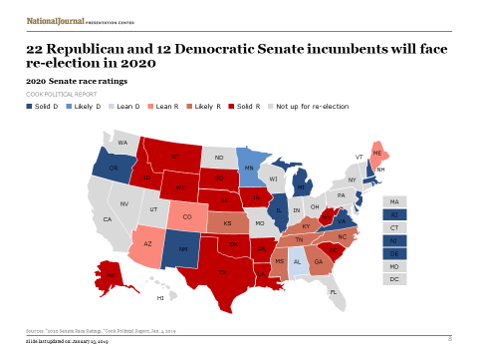
2020 Election
American Subcontractors Association
www.asaonline.com | www.subexcel.com | http://contractorscompass.org

Slide 14
ASA Task Force on Government Advocacy
American Subcontractors Association
1004 Duke St., Alexandria, VA 22314
www.asaonline.com | www.subexcel.com | http://contractorscompass.org

Slide 15
Legislative Update
SUBS Act – Bid Listing
Retainage – Reduction to 5% for all federal contracts
Miller Act – Bonding Requirements
P3 Bonding Requirements in TIFIA (Transportation Infrastructure Finance + Innovation Act)
Change Orders
Reverse Auction
American Subcontractors Association
1004 Duke St., Alexandria, VA 22314
www.asaonline.com | www.subexcel.com | http://contractorscompass.org

Slide 16
Legislative Update
2020 National Defense Authorization Act (NDAA)
Sec. 828 - Enhanced post-award debriefing rights
Sec. 829 - Standardizing data collection and reporting on use of source selection procedures by Federal agencies
Sec. 872(d) - Accelerated payments applicable to contracts with certain small business concerns under the Prompt Payment Act
Sec. 873 - Modifications to small business subcontracting
Sec. 877 - Exemption of certain contracts from the periodic inflation adjustments to the acquisition-related dollar threshold
Sec. 881 - Permanent authorization and improvement of Department of Defense Mentor-Protege Program
American Subcontractors Association
1004 Duke St., Alexandria, VA 22314
www.asaonline.com | www.subexcel.com | http://contractorscompass.org

Slide 17
Legislative Update
2020 National Defense Authorization Act (NDAA)
Sec. 883 - Reporting on expenses incurred for bid and proposal costs
Sec. 884 -Postaward explanations for unsuccessful offerors for certain contracts.
Sec. 899J - Pilot program on payment of costs for denied Government Accountability Office bid protests.
Sec. 899E - Prohibition on contracting with persons with willful or repeated violations of the Fair Labor Standards Act of 1938.
American Subcontractors Association
1004 Duke St., Alexandria, VA 22314
www.asaonline.com | www.subexcel.com | http://contractorscompass.org

Slide 18
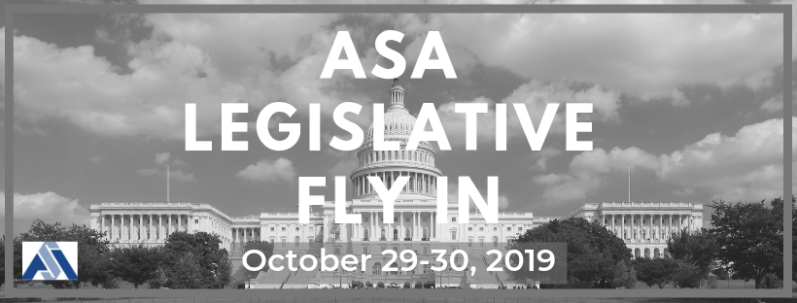
Fly-In program Includes:
Meeting on The Hill with your Members of Congress or their staff
A briefing session on ASA's legislative priorities in Congress and training on lobbying and influencing your elected officials
Networking with your ASA peers from across the country
Registration: $125 per person
Registration is now open through July 31, 2019. Fees include briefing sessions, breakfast, group reception and dinner. Hotel information will be provided to Fly In registrants following the July 31st deadline.
Lodging: We will be confirming hotel and booking information following the July 31st registration deadline. Rates for Washington, DC at this time of year are expected to be between $300 - $400 per night.
Schedule-at-a-Glance:
Tuesday, October 29, 2019
TBD Afternoon Group Activity
3:30pm - 5:30pm Mandatory Briefing Session on ASA Legislative Priorities & Fly-In Protocol
7:00pm Networking Cocktail Reception & Dinner
Wednesday, October 30, 2019
7:00am - 8:30am Breakfast
9:30am - 5:00pm Meetings on Capitol Hill
For more information or to register: https://members.asaonline.com/ap/Events/Register/9pQYonbp?sourceTypeId=EmailInvitation
American Subcontractors Association
www.asaonline.com | www.subexcel.com | http://contractorscompass.org

Slide 19
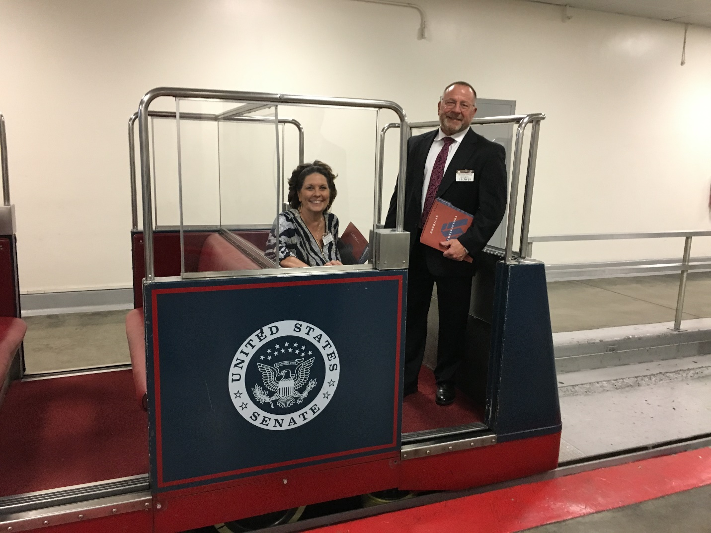
American Subcontractors Association
www.asaonline.com | www.subexcel.com | http://contractorscompass.org

Slide 20
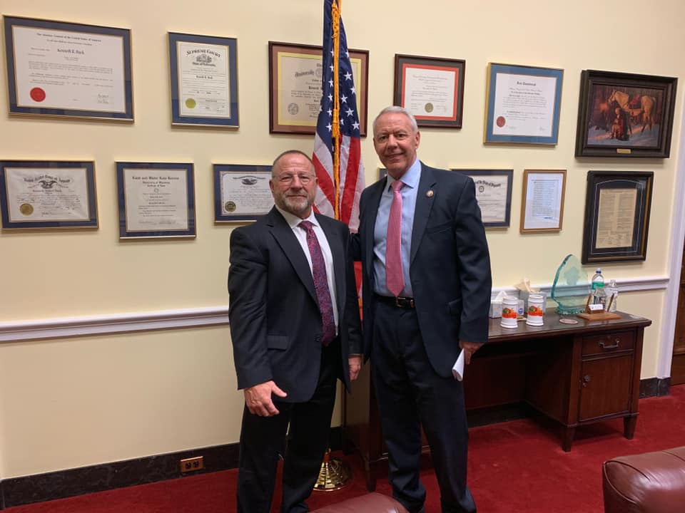
American Subcontractors Association
www.asaonline.com | www.subexcel.com | http://contractorscompass.org

Slide 21
Regulatory Update – Unfair Competition
Government Accountability Office (GAO) begins auditing the Federal Prison Industries (FPI) authorized by Congress with the passage of the FIRST STEP Act of 2018 (P.L.115-391) signed into law on December 21, 2018.
ASA meets with GAO on August 29, 2019 and these are the questions posed:
Please identify the challenges, if any, private companies face in competing with FPI.
FPI’s sales have declined when compared to the early 2000s. Has the extent of the burden, if any, FPI places on the private sector declined commensurately?
Please identify those elements of prior reform efforts that remain relevant today.
What are the primary differences in the cost structure between FPI and private sector (non-profit, as applicable) producers and how are these differences reflected in product prices?
To what extent have you analyzed the effect of the First Step Act’s expansion of markets available to FPI? Are there any recent analyses of FPI of which we should be aware?
American Subcontractors Association
1004 Duke St., Alexandria, VA 22314
www.asaonline.com | www.subexcel.com | http://contractorscompass.org

Slide 22
Regulatory Update – Silica
ASA is a member of the Construction Industry Safety Coalition (CISC)
The Silica Request for Information (RFI) was officially published in the Federal Register: https://www.govinfo.gov/content/pkg/FR-2019-08-15/pdf/2019-17450.pdf. Comments are due October 15, 2019.
ASA, along with the CISC, is responding to the 31 questions OSHA has asked regarding the effectiveness of dust control methods not currently included in Table 1 of the silica in construction standard.
American Subcontractors Association
1004 Duke St., Alexandria, VA 22314
www.asaonline.com | www.subexcel.com | http://contractorscompass.org

Slide 23
Regulatory Update – Small Business Administration
The federal government is required to allocate at least 23% of its direct contract spending to small businesses.
The Small Business Administration's annual scorecards track progress toward that goal.
SBA changed how it calculates scores for fiscal year 2017 but didn't initially plan to evaluate the effect of the changes.
GAO recommended SBA evaluate its new scoring methodology to assess how effectively the scorecards measure agency performance and promote contracting opportunities for small businesses.
ASA is working with members of Congress and congressional staff to address these recommendations.
American Subcontractors Association
1004 Duke St., Alexandria, VA 22314
www.asaonline.com | www.subexcel.com | http://contractorscompass.org

Slide 24
Subcontractor Legal Defense Fund
Activity Report
By Shannon Oscar
Managing Director, ASA Task Forces
American Subcontractors Association
American Subcontractors Association
1004 Duke St., Alexandria, VA 22314
www.asaonline.com | www.subexcel.com | http://contractorscompass.org

Slide 25
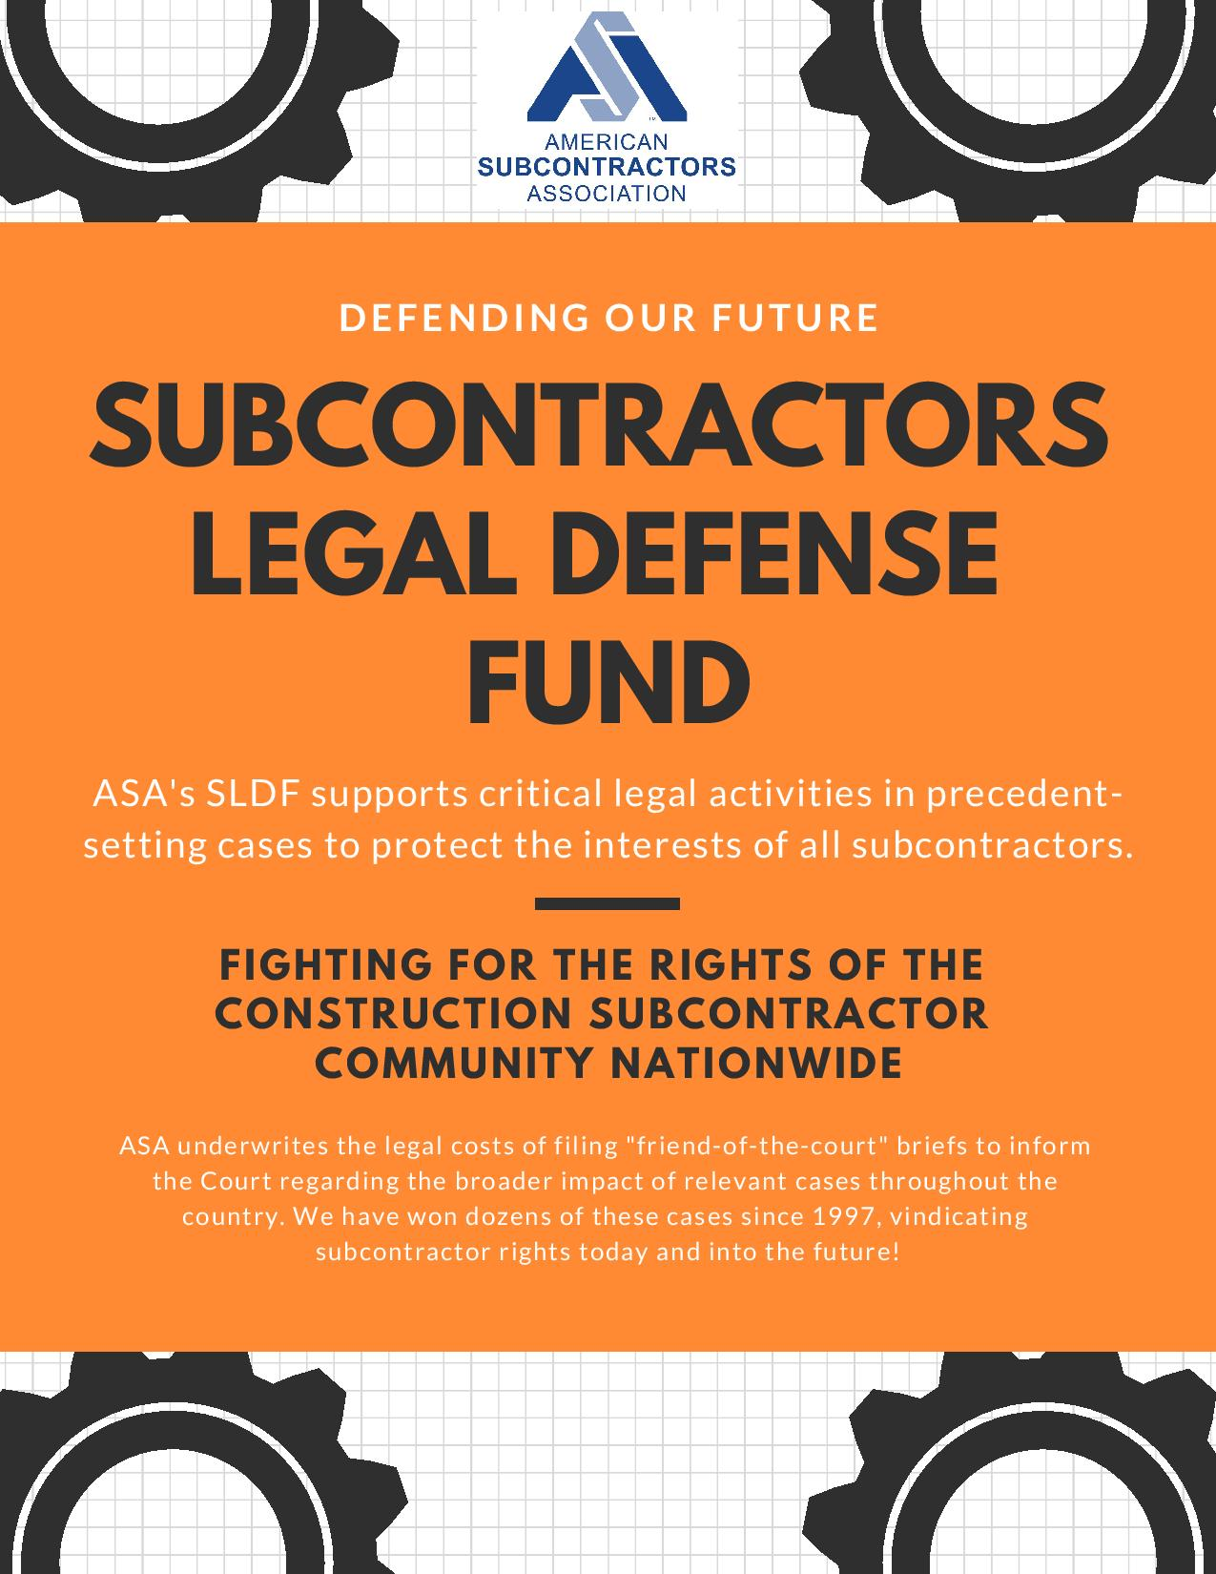
American Subcontractors Association
www.asaonline.com | www.subexcel.com | http://contractorscompass.org

Slide 26
Snake Steel, Inc. v. Holladay Construction, Inc.
The subcontractor (the Sub) is appealing a trial court decision under the Tennessee Prompt Pay Act (TPPA).
The dispute arose out of $15 million construction project between the owner, GC, and the Sub, Snake Steel, Inc.
On 10/24/14, the Sub completed the work, and the GC paid the sub except for a change order and the 5% retainage amount.
Owner paid the retainage to the GC, but the GC neither passed the retainage amount to the Sub or deposited it into an escrow account as per TPPA.
After three years of not receiving full payment, the Sub was paid by the GC without realizing the Sub’s right to claim for interest, attorneys fees, plus $300.00, which is a TPPA requirement, if the retainage holder (the GC) failed to open an escrow account.
The trial court claimed the Sub time barred by the one year statute of limitations and the Sub’s claim accured when it billed for the retainage more than one year before filing suit.
In 2/16, the Sub invoiced GC for final payment (retainage + change order).
On 9/25/17, the Sub still not paid, but filed a compliant against the GC.
In 12/17, the Sub paid in full.
American Subcontractors Association
www.asaonline.com | www.subexcel.com | http://contractorscompass.org

Slide 27
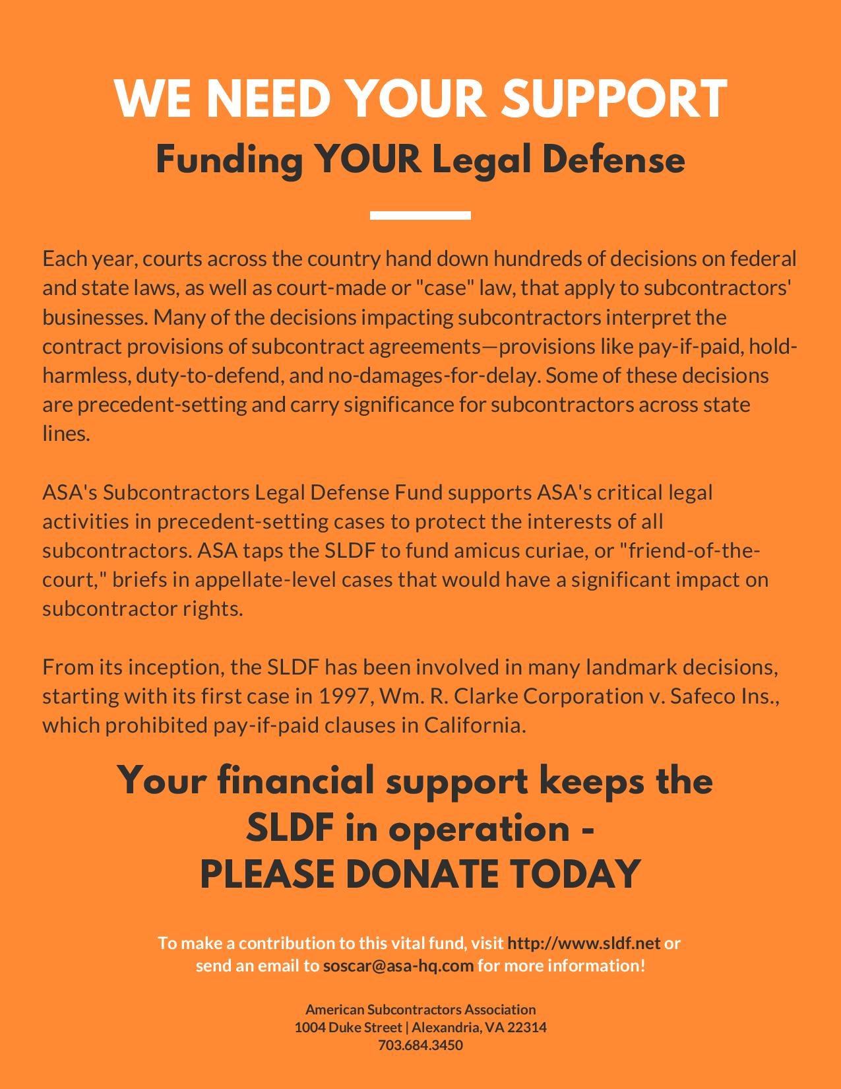
American Subcontractors Association
www.asaonline.com | www.subexcel.com | http://contractorscompass.org

Slide 28
State Chapter Voter Voice
Activity Report
By Timothy Ward
Government Relations Communications Director
American Subcontractors Association
American Subcontractors Association
1004 Duke St., Alexandria, VA 22314
www.asaonline.com | www.subexcel.com | http://contractorscompass.org

Slide 29
ASA Chapter | Date | Legislative Topic | Position | # of ASA Participants | Bill Status
ASA of Tennessee | 2/20/19 | Retainage; Stop Work; Ban pay-if-paid clauses | Support | 45 | Pending
ASA of Oklahoma | 3/11/19 | Retainage; Construction procurement | Support | 20 | Enacted May 15, 2019
ASA of Texas | 3/15/19 | Bans local employment ordinances | Support | 13 | Pending
ASA of Metro Washington | 4/2/19 | Retainage | Support | 9 | Enacted April 30, 2019
ASA of Texas | 4/22/19 | Construction Defect Litigation; Right-to-Repair; Attorney fee loophole | Support | 74 | Construction Defect and Right-to-Repair legislation enacted June 14, 2019
ASA of Texas | 4/26/2019 | Uniform statewide employment regulations | Support | 29 | Pending
 |  |  | Total: | 190
*ASA of Texas includes ASA of North Texas, San Antonio and Houston
American Subcontractors Association
www.asaonline.com | www.subexcel.com | http://contractorscompass.org

Slide 30
In Conclusion
“A great challenge in politics and diplomacy is to see in real time the line between the opening that should be pursued and the trap that must be avoided. And once you made that calculation, not push things too far. It can be delicate. You have to be like a safecracker, who files down his fingers so he’ll feel every click.”
Declarations by Peggy Noonan, Wall Street Journal, September 8, 2019.
American Subcontractors Association
1004 Duke St., Alexandria, VA 22314
www.asaonline.com | www.subexcel.com | http://contractorscompass.org

Slide 31
Questions / Comments
American Subcontractors Association
www.asaonline.com | www.subexcel.com | http://contractorscompass.org

